Slide 1

Healthcare Duplicate MRN Continuous Improvement Analysis
Using Python, SQL, and Power BI to Identify Opportunities for Reducing Duplicate MRNs
Jen Fordham Healthcare Analytics Portfolio July 2026
Notes:
This project demonstrates an end-to-end healthcare analytics solution focused on reducing duplicate medical record numbers. I used Python, SQL, and Power BI to simulate realistic duplicate investigations, analyze trends, and present actionable recommendations through an interactive dashboard.

Slide 2

What problem are we trying to solve?
Business Problem
Duplicate medical record numbers (MRNs) create operational inefficiencies, increase duplicate investigation workload, and can contribute to patient safety risks if patient information is fragmented across multiple records.
Project Goal
Identify the highest-impact process improvement opportunities for reducing duplicate MRNs through analysis of duplicate investigation data.
Notes:
Duplicate MRNs create operational inefficiencies because staff must investigate and merge duplicate patient records. They can also contribute to patient safety risks if information becomes fragmented across multiple records.
Rather than measuring operational performance, my goal was to identify the highest-impact opportunities for improving registration workflows and reducing duplicate record creation.

Slide 3

How was the solution developed?
Workflow
Business Problem
Domain Knowledge
Python Simulation
SQL Analysis
Power BI Dashboard
Recommendations
Technology Stack
Python (data simulation)
SQL (business analysis)
Power BI (visualization)
Why synthetic data?
Synthetic data was modeled after realistic healthcare registration workflows to demonstrate an end-to-end analytics solution while protecting patient privacy.
Notes:
Before building the dashboard, I designed an end-to-end analytics workflow. Starting with the business problem, I applied healthcare domain knowledge to generate a realistic synthetic dataset, analyzed it with SQL, and then built an interactive Power BI dashboard. Synthetic data allowed me to demonstrate the complete analytics process while protecting patient privacy.

Slide 4

How was the solution built?
🐍 Python Data Generation
1,000 synthetic duplicate investigations
Weighted probability simulation
Source-specific business rules
🧠 Healthcare Workflow Rules
Mutually exclusive contributing factors
Realistic healthcare registration workflows
Categorized contributing factors into five primary categories
🗄️ SQL Analysis
Business question-driven SQL queries
Aggregated trends using GROUP BY, COUNT, and ORDER BY
Summarized trends by source, department, contributing factor, and month
📊 Power BI
Two-page executive dashboard
Interactive Opportunity Explorer
Continuous improvement-focused reporting
Notes:
🎤 Speaker Notes — How was the solution built?
This slide highlights the four primary technical components of the project.
First, I used Python to generate a synthetic dataset of 1,000 duplicate MRN investigations. Rather than creating random data, I modeled realistic healthcare registration workflows using weighted probability distributions and source-specific business rules.
Next, I wrote SQL queries to answer the key business questions before building the dashboard. These queries summarized duplicate investigations by source, department, contributing factor, and month.
Finally, I developed a two-page Power BI dashboard designed for continuous improvement. Instead of simply reporting metrics, the dashboard helps stakeholders identify where process changes could reduce duplicate medical records.

Slide 5

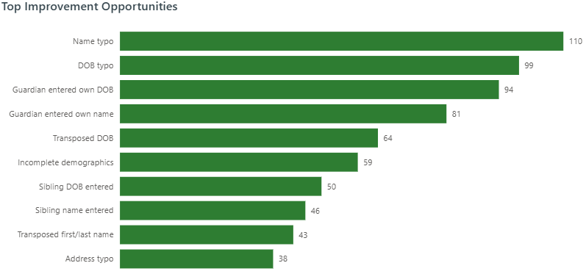
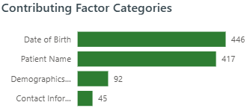
What did the analysis reveal?
Key Insights
① Self-Schedule generated the highest duplicate volume (34.5%).
② Registration data accuracy represents the largest improvement opportunity.
③ Patient Name and Date of Birth accounted for most duplicate investigations.
Notes:
This dashboard summarizes the primary findings from the analysis. It provides an executive-level view of duplicate investigations, highlighting overall duplicate volume, the highest-volume source, and the most common contributing factors.
Three insights stood out. First, Self-Schedule accounted for the highest proportion of duplicate investigations, suggesting that self-registration workflows are a key area for process improvement. Second, registration data accuracy emerged as the largest opportunity to reduce duplicate record creation. Finally, patient name and date of birth issues represented the majority of duplicate categories, indicating that improvements to patient identification processes could have the greatest impact.

Slide 6

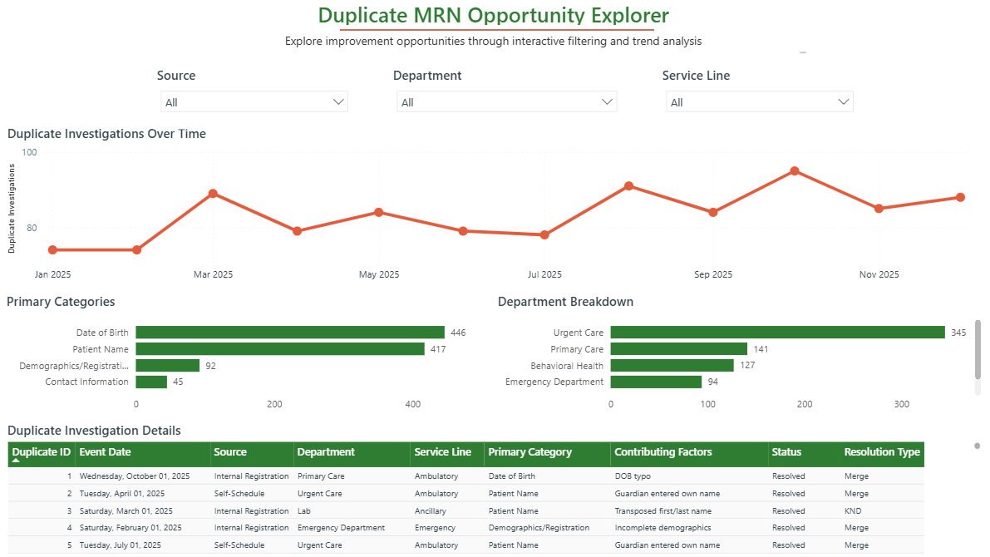
How can stakeholders explore improvement opportunities?
Opportunity Explorer
Enables department leaders to investigate duplicate MRN patterns through interactive filtering and drill-down analysis.
Capabilities
✓ Compare duplicate trends by source
✓ Identify high-volume departments
✓ Explore service-line trends
✓ Monitor trends over time
✓ Review investigations details
Notes:
This page demonstrates how stakeholders can interact with the dashboard beyond the executive summary. Rather than presenting static metrics, the Opportunity Explorer allows users to filter duplicate investigations by source, department, and service line to identify localized trends.
Users can monitor monthly duplicate patterns, compare duplicate categories across departments, and review individual investigation details. This design supports continuous improvement by helping operational leaders identify where targeted process changes may have the greatest impact.

Slide 7

Recommended Process Improvements
Recommendations aligned to the highest-impact findings
Improve Self-Schedule Registration
Collaborate with the Self-Schedule team to simplify parent registration workflows and clarify field instructions.
Addresses the highest-volume duplicate source.
Reinforce Reliable Search Method (RSM)
Reinforce the RSM for internal registration staff and external providers through refresher education and targeted reminders.
Reduces duplicate creation before new MRNs are generated.
Reinforce Registration Safety Tools
Reinforce use of safety tools such as STAR (Stop, Think, Act, Review) and Repeat-Back to ensure accurate chart registration and searches.
Improves registration data accuracy.
Targeted Duplicate MRN Training
Require frequent duplicate creators to complete the "Duplicate MRNs & Overlays" learning course.
Provides targeted coaching based on performance.
Monitor Department Performance
Provide department leaders with a real-time dashboard and conduct quarterly quality improvement rounding to monitor duplicate trends.
Supports continuous improvement and accountability.
Notes:
Example process improvement strategies are based on common healthcare quality improvement practices and professional experience.
Based on the analysis, I developed five recommended process improvements that align directly with the highest-impact findings. The recommendations focus on preventing duplicate creation at the source, improving registration accuracy, providing targeted education, and establishing ongoing performance monitoring. These examples reflect common healthcare quality improvement practices and demonstrate how analytics can inform operational decision-making.

Slide 8
Thank you / Questions
Thank you for your time and feedback.
Jen Fordham
Healthcare Analytics Portfolio
July 2026
Notes:
Although the dataset is synthetic to protect patient privacy, the workflow, business rules, analytical approach, and dashboard design reflect the type of continuous improvement work commonly performed in healthcare analytics.

